Slide 1
Router/Firewall
KOHS Cyber Hygiene training

Slide 2


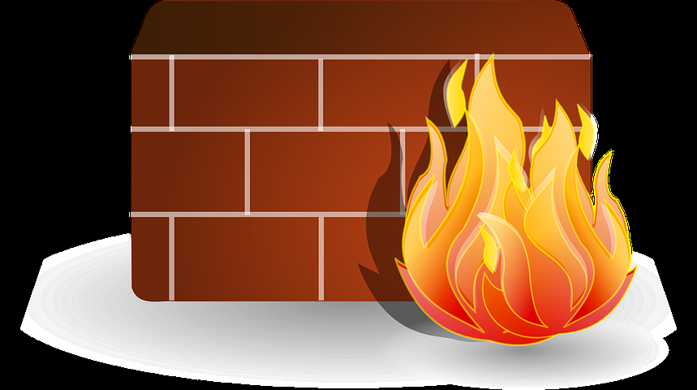

Why is a firewall needed?
As you now know, your network links to the outside world through your router
A firewall is needed to protect both your network from threats in the outside world and to protect the outside world from possible threats on your network
Think of a firewall as a fence around your house
YOUR FIREWALL
YOU
THREATS FROM THE INTERNET

Slide 3

What is this A firewall?
A router allows your network to communicate with the world, a firewall is the gatekeeper within your router
Like the example of the fence around your house, you get to chose who you let in and who to keep out
A strong fence may not keep everything out, but it will deter most threats
A firewall is program to keep certain bad software out, let good software in, and ask you about unknown software
Email from mom
Virus
Malware
Bank transaction
Excel file
worm

Slide 4
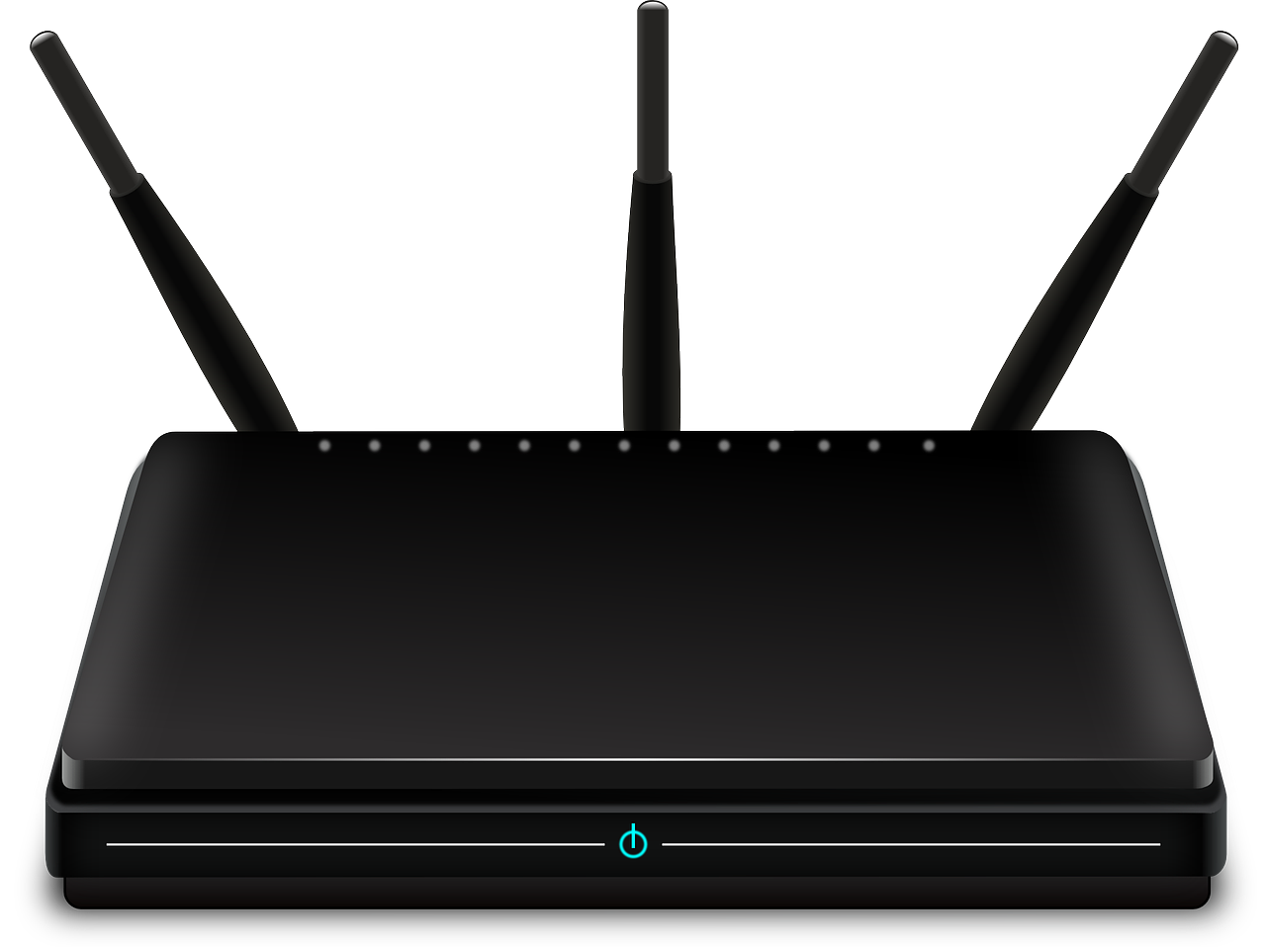

How are they different?
While a router and a firewall are often physically housed in the same unit there are a few important differences
Mainly, a router shuffles data back and forth between networks and a firewall determines which of that information is safe to let in or out

Slide 5






Firewall Game (i’m thinking a guitar hero type game, hit what is good let go what is bad)

